Slide 1
ANNE VERONICA 1
PRIYA GUPTA 20
SHUBH PATEL 60
BHAVANA PRAJAPATI 66
POOJA PRAMANIK 67
HEETA TALAVIYA 92
GLORY LITHIYAL 95
NITESH GUPTA 111
AMAN UPADHYAY 132
DEEPAK KESHRI 134
SURYASEN VISHWAKARMA 139

Slide 2
PEP8
PEP8 is a style guide for python code.
→ PEP stands for Python Enhancement Proposal, and they describe and document the way python language evolves.
→ It was written in 2001 by Guido van Rossum, Barry Warsaw, and Nick Coghlan.
→ A PEP is a document that describes new features proposed for Python and documents aspects of Python, like design and style, for the community.
→ They also provide a reference point (and a standard) for the pythonic way to write code

Slide 3
→ It also has a lot of programming recommendations and useful tips on various topics, which aim to improve readability and reliability of your code.
→ PEP8 features:-
I. Plugin architecture: Adding new checks is easy.
Parseable output: Jump to error location in
your editor.
3. Small: Just one Python file, requires only stdlib. You can use just the pep8.py file for this purpose.

Slide 4
Naming Conventions
Naming Conventions:
1.Variable
2.Function
3.Class
4.Method
5.Constant
6.Module
7.Package
`

Slide 5
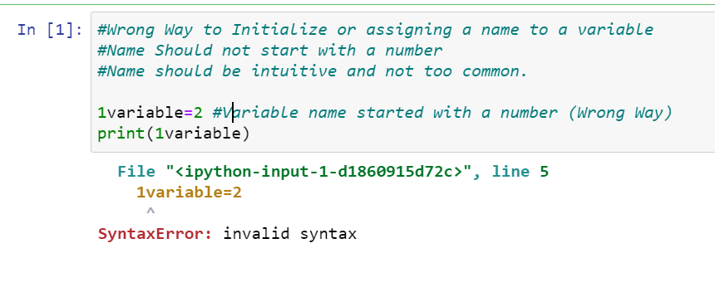
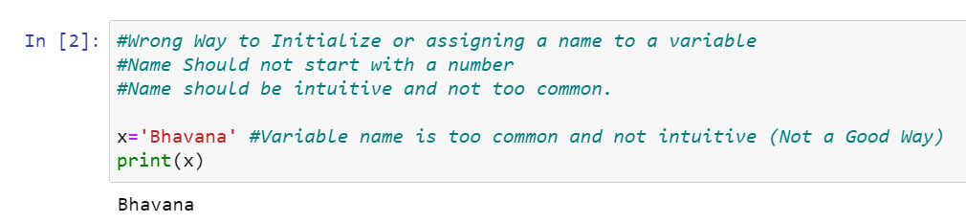
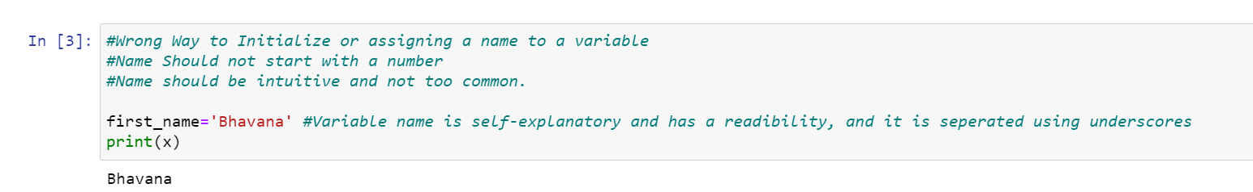
Variable: A variable is created the moment you first assign a value to it

Slide 6
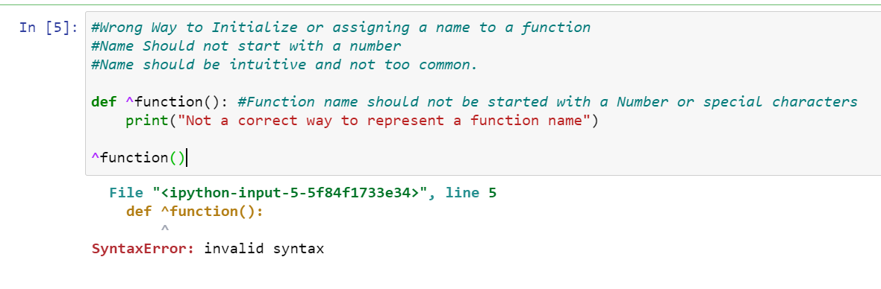
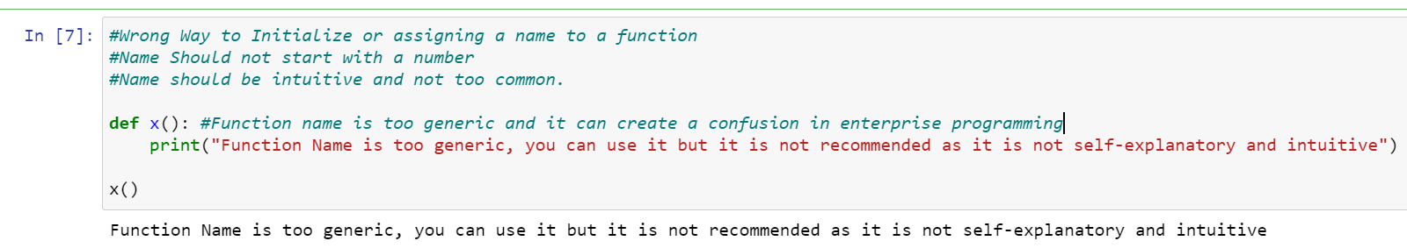
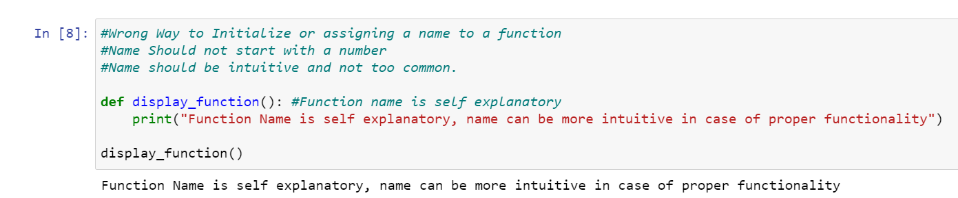
Function: A function is a block of code which only runs when it is called.

Slide 7
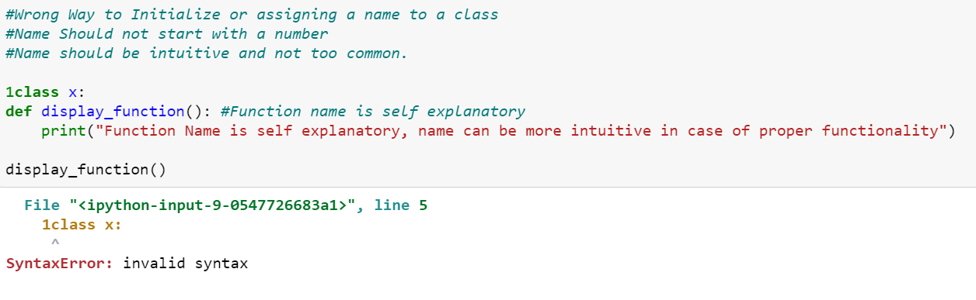
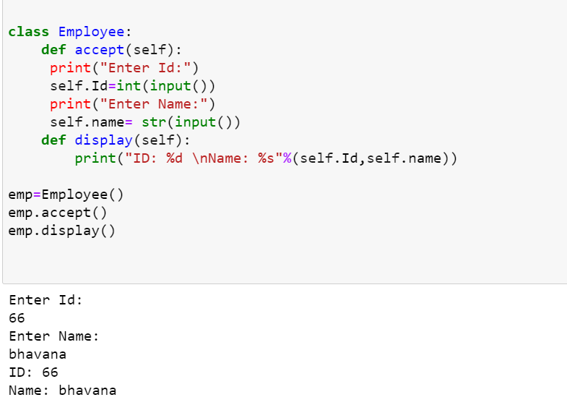
Class: class definitions begin with a class keyword.

Slide 8
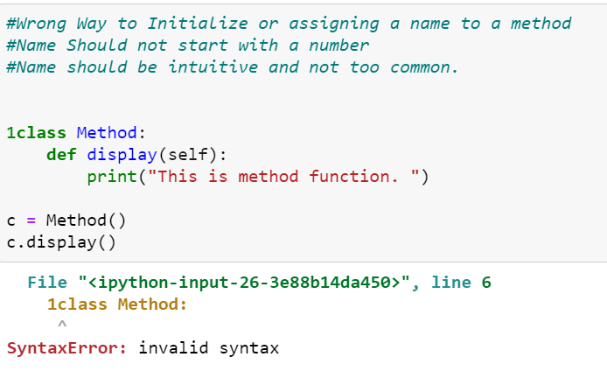
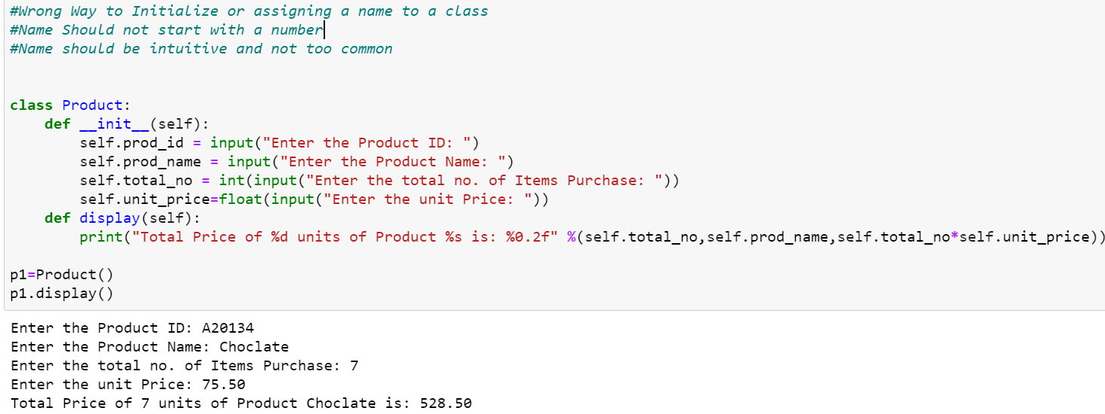
Method: A Python method is a label that you can call on an object; it is a piece of code to execute on that object.

Slide 9
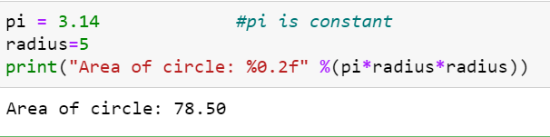
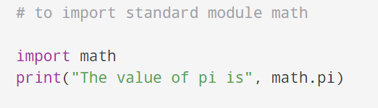
Constant: A constant is a type of variable whose value cannot be changed.
Modules: Modules refer to a file containing Python statements and definitions.

Slide 10
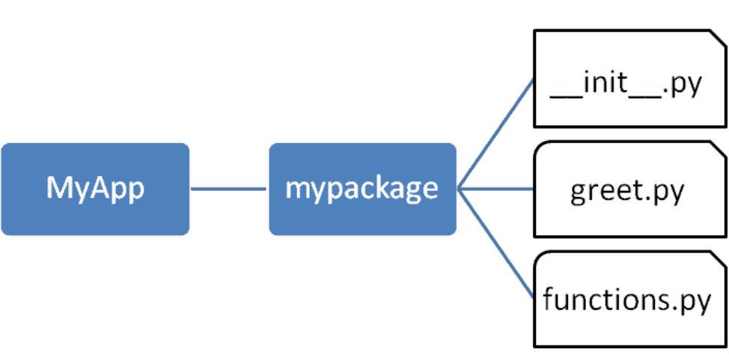
Packages: A package is basically a directory with Python files and a file with the name __init__ . py

Slide 11
Code layout
WITHOUT SPACE
These conventions lead to text that you can read easily, like this:
This would become increasingly hard to read. For example have a look at the example below
WITH SPACE
Now here, we will use space and write it in regular English language, so it will be very easy to read.

Slide 12
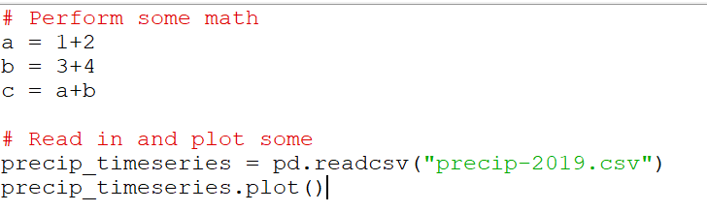
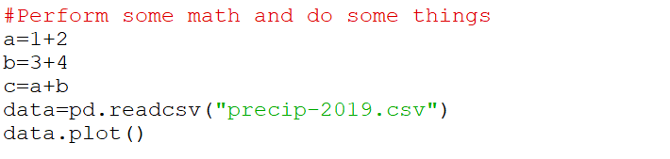
Maximum line length and line breaking
PEP 8 guidelines suggest that each line of code (as well as comment lines) should be 79 characters wide or less. This is a common standard that is also used in other languages including R.
# CORRECT
#WRONG

Slide 13
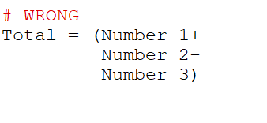
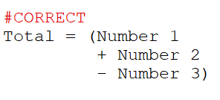
Should a line break Before or After a Binary Operator
Here, it’s harder to see which variable is being added and which is subtracted.
You can immediately see which variable is being added or subtracted, as the operator is right next to the variable being operated on.
In the below Example

Slide 14
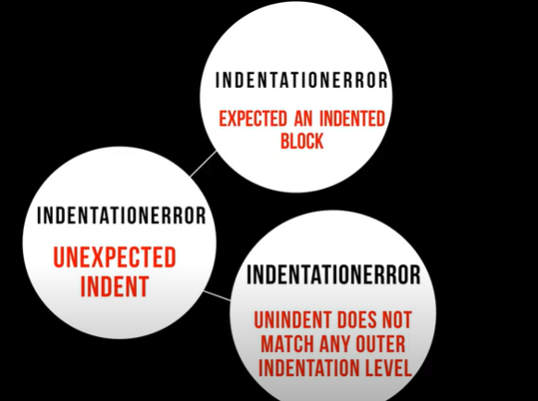
Indentation
Indentation is extremely important in Python.
The Indentation level of lines of code in python determines how statements are grouped together.

Slide 15
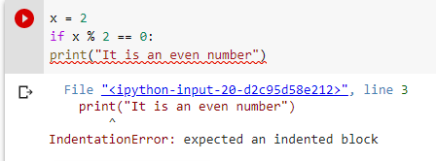
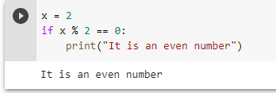
Expected an indented block

Slide 16
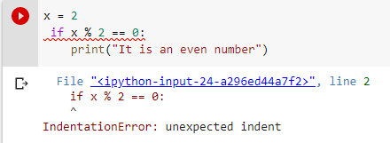
2. Unexpected Indent

Slide 17
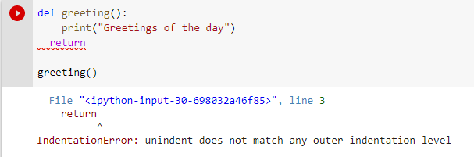
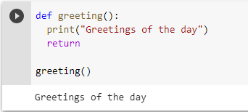
3. Unindent does not match any outer indentation level

Slide 18


Tabs vs. Spaces
Indentation following line breaks

Slide 19
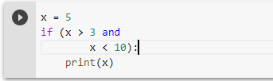
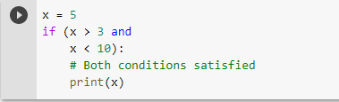
# Not Recommended
# Recommended

Slide 20




# Not Recommended
# Recommended
# Not Recommended
# Recommended

Slide 21
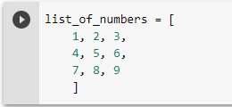
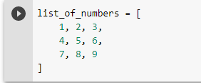
Where to put the closing Braces
Method
2. Method

Slide 22
COMMENTS:
Comments are lines that exist in computer programs that are ignored by compilers and interpreters.
Comment begins with a hash mark (#)
Generally, comment looks like this:
# this a comment
Because comment does not execute ,when you will run program you will not see any indication of the comment there.

Slide 23
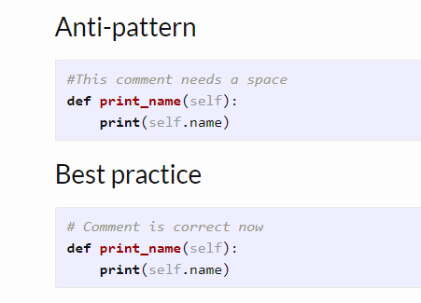
BLOCK COMMENTS:
Each line of block comments starts with a # and a single space
Paragraphs inside a block comment are separated by a line containing a single #.

Slide 24
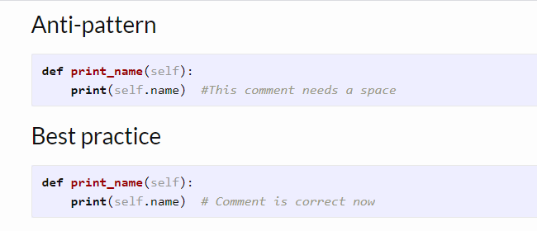
INLINE COMMENTS:
Inline comment should be separated by at least two spaces from the comment.
They should start with a # and a single space
Inline comments are unnecessary and in fact distracting if they state the obvious

Slide 25
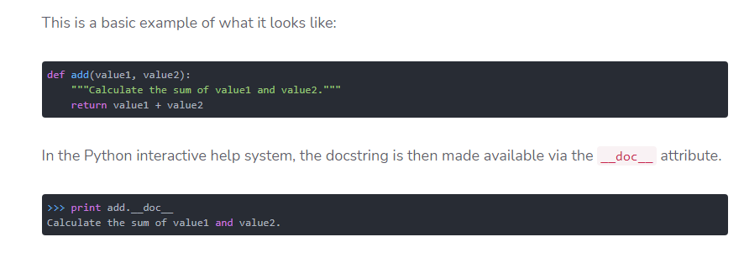
DOCSTRING COMMENTS:
A docstring is added as a comment string right below the function,module,or object
RULES:
A docstring is either a single line, or a multi-line comment
In latter case, the first line is short description, and after the first line an empty line follows

Slide 26
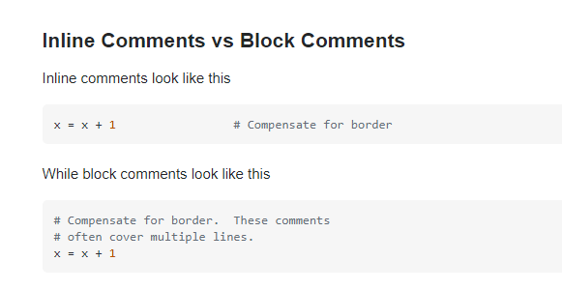

Slide 27
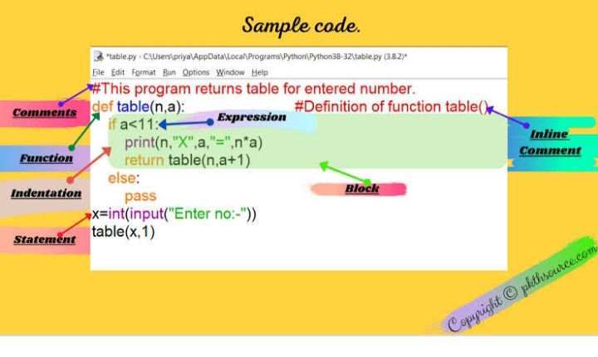

Slide 28
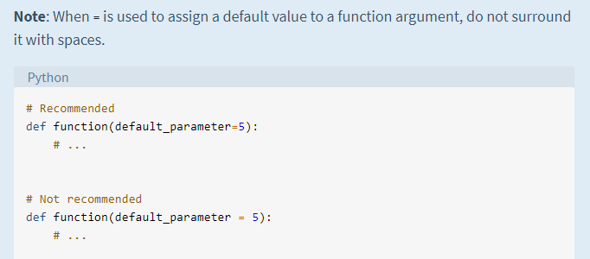
Whitespace in Expressions and Statements
Whitespace Around Binary Operators
Surround the following binary operators with a single space on either side:
Assignment operators (=, +=, -=, and so forth)
Comparisons (==, !=, >, <. >=, <=) and (is, is not, in, not in)
Booleans (and, not, or)

Slide 29
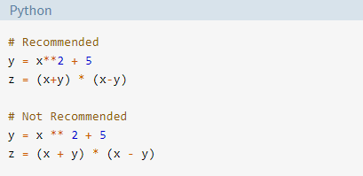
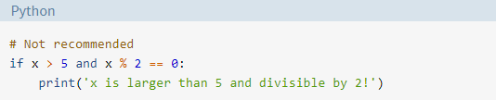
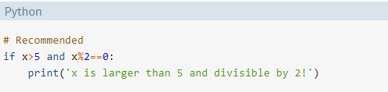
Adding space when there is more than one operator in a statement.
Adding space to if statements where there are multiple conditions.

Slide 30
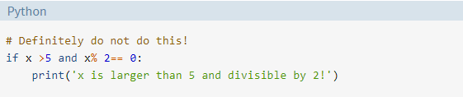
Note : Use the same amount of whitespace either side of the operator.
The following is not acceptable :

Slide 31
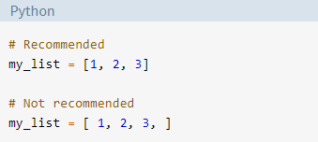
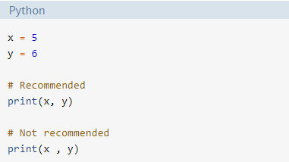
When to Avoid Adding Whitespace
Trailing space
Immediately inside parentheses, brackets, or braces:
Before a comma, semicolon, or colon:

Slide 32
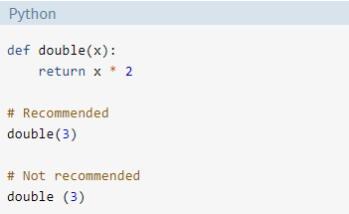
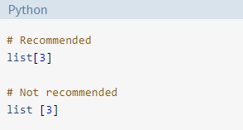
Before the open parenthesis that starts the argument list of a function call:
Before the open bracket that starts an index or slice:

Slide 33
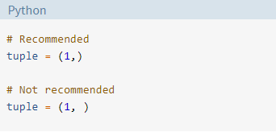
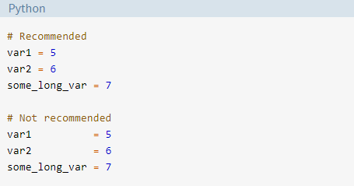
Between a trailing comma and a closing parenthesis:
To align assignment operators:

Slide 34
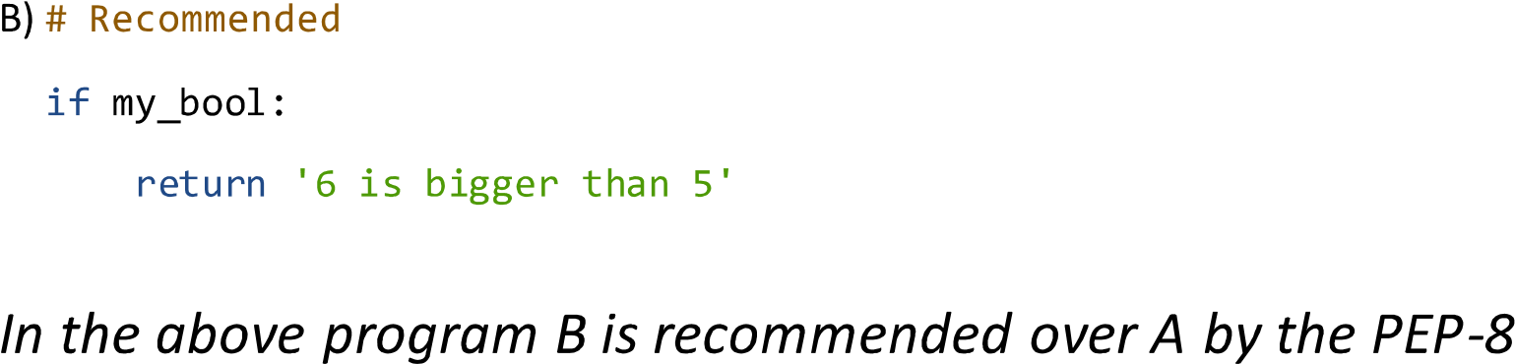

Slide 36
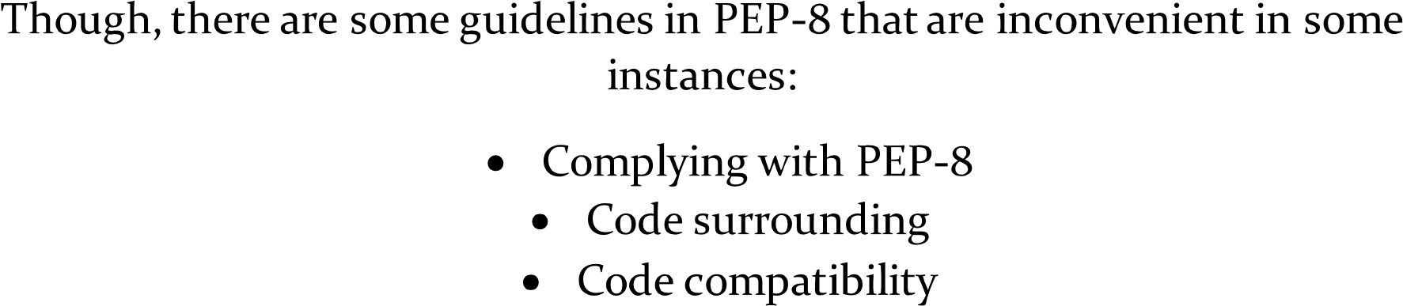

Slide 37
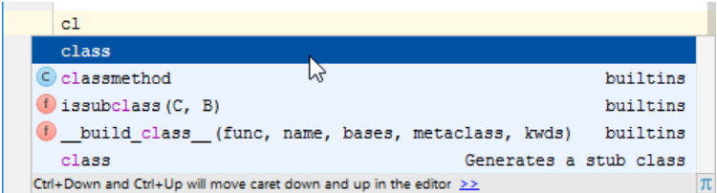
Tips and Tricks to Help Ensure
Your Code Follows PEP 8
Highliting code style violations:
(Refer to Code Completion page of the product documentation for details.)
Generating Source code:
Select if option from the suggestion list. As you see, PyCharm automatically adds if True: and indents the selected lines:

Slide 38
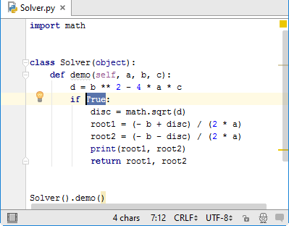
Linter-python-pep8 package
This linter-python-pep8 plugin or Linter provides an interface to pep8. It will be used with files that have the Python syntax.
Installation:
Before using this plugin, you should make sure that pep8 is installed on your system. You can follow following instructions to install pep8:
Install python.
Install pep8 by typing the following in a terminal:
pip install pep8

Slide 39
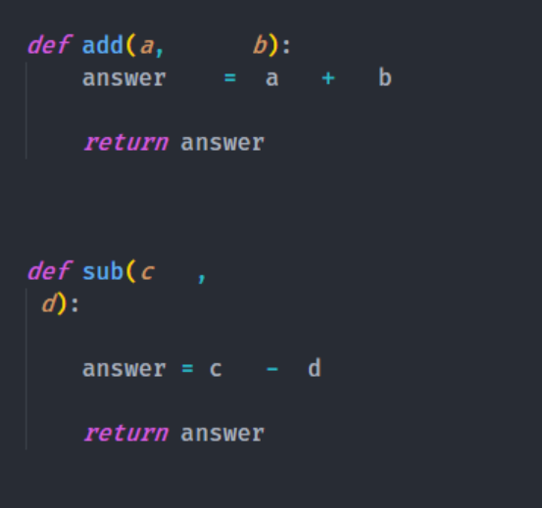
Black
Black can be installed by running pip install black. It requires Python 3.6.0+ to run. Once Black is installed, you will have a new command-line tools called black available to you in your shell, and you’re ready to start.
Format a Single File:
Let’s look at this simple example: here are my two python functions in my python file called sample_code.py.

Slide 40

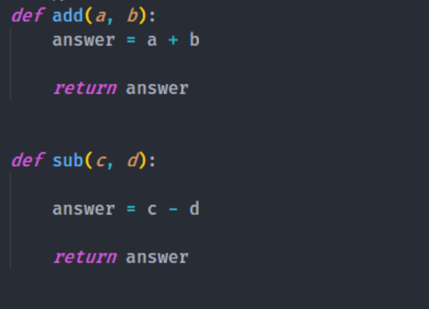
You can use black sample_code.py in the terminal to change the format. After running Black, you will see the following output:
Then you open sample_code.py to see formatted python code:

Slide 41
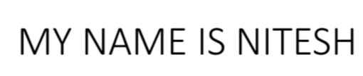

Example of code and layout.
With space and without space.
WITH SPACE.
*ex-
WITHOUT SPACE.
*ex-

Slide 42


Maximum line length and line breaking.
Ex-
Ex-

Slide 43


Should a line break Before or After A Binary Operator.
Ex-
Ex-

Slide 44


Example of comments.
block comment.
Anti-partten.
Best-pratice.

Slide 45


Inline comments.
Anti-partten.
Best practice.

Slide 46

Documentation string comment.

Slide 47


EXAMPLE OF NAMING CONVENTION
NAMING MODULE WITH HELP OF PEP8
# Not recommended
# Recommended

Slide 48
NAMING VERIABLE WITH HELP OF PEP8
Veriable:
>>> # Not recommended
>>> x = 'John Smith'
>>> y, z = x.split()
>>> print(z, y, sep=', ')
'Smith, John'
>>>
>>> # Recommended
>>> name = 'John Smith'
>>> first_name, last_name = name.split()
>>> print(last_name, first_name, sep=', ')
'Smith, John'

Slide 49


EXAMPLES OF INDENTATION
METHODS OF WHERE TO PUT CLOSING BRACES:-

Slide 50


Methods for following line breaks

Slide 51


EXAMPLE OF WHITESPACING
Adding space when there is more than one operator in a statement.

Slide 52


Adding space to if statemennts where there are multiple conditions.

